Slide 1

Introduction to SPSS
Presented by Maya Pilin
Centre for Scholarly Communication
UBCO
Notes:
Introduce myself here

Slide 2
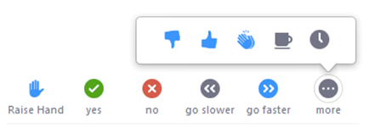
Zoom Protocol
Notes:
Press Raise hand to ask question
Press YES or NO when I check in to see if you are keeping up
PM Mathew if you are having technical difficulties - breakout room

Slide 3
If you leave the Zoom call accidentally and need to re-enter, you can click the link in your email. If you cannot find it, please email Mathew at mathew.vis-dunbar@ubc.ca

Slide 4
Broad Learning Objective
Students will leave the workshop with a basic knowledge of
how to operate SPSS
the layout of the program
the capabilities of SPSS
resources for further assistance with SPSS

Slide 5
The Schedule
Part 1: Vocabulary (30 mins)
Part 2: Downloading SPSS (30 mins)
Part 3: Importing & sorting data, organizing variables (30 mins)
Part 4: Transforming data & using descriptive stats (30 mins)
Part 5: Visual data representation (30 mins)
Part 6: Syntax and resources (30 mins)

Slide 6
QUESTION Why are you learning how to use SPSS?

Slide 7
Excel v. SPSS
Excel:
More difficult to learn
Not very well set-up for most types of statistical analyses
GREAT for organizing data
Requires some coding knowledge
SPSS
Easier to learn
Designed for statistical analyses
Does not have many data organization features
Does not require coding knowledge

Slide 8
Section 1: Vocabulary

Slide 9
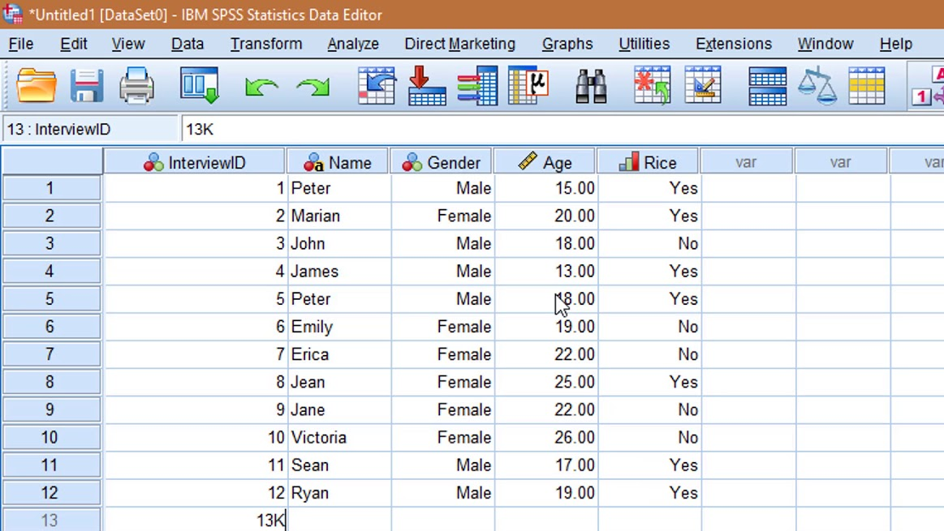
SPSS
A program that allows you to analyze data via an easy-to-use point-and-click format.

Slide 10
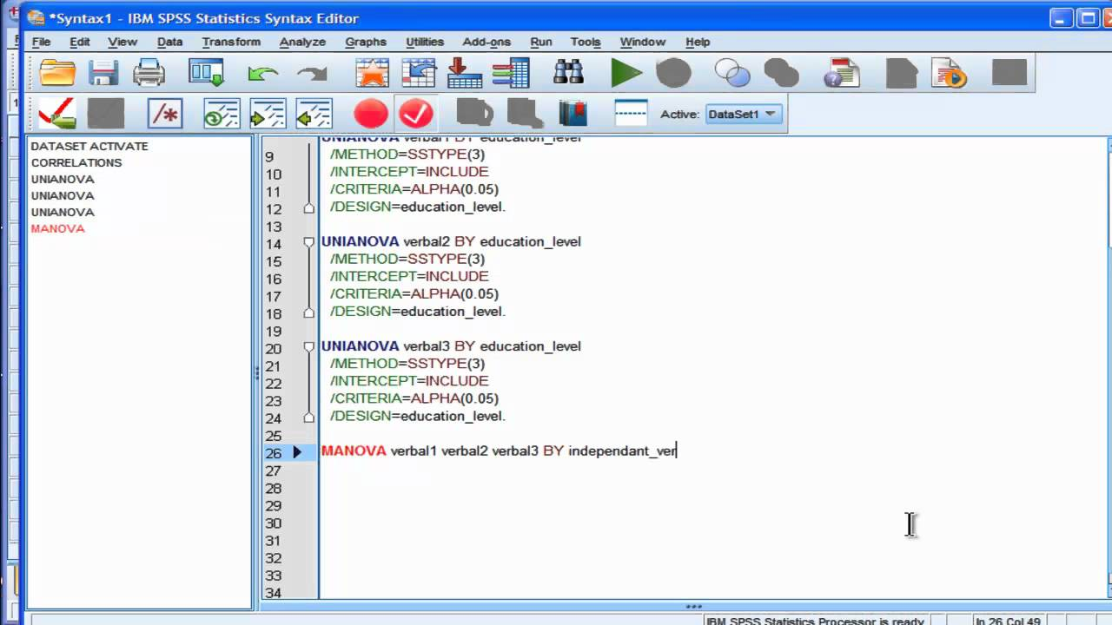
Syntax
The code that allows you to run analyses and commands via SPSS.

Slide 11
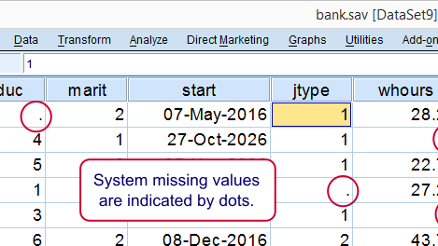
Missing Value
A response that does not count as valid data and that you do not want to include in your analyses.

Slide 12
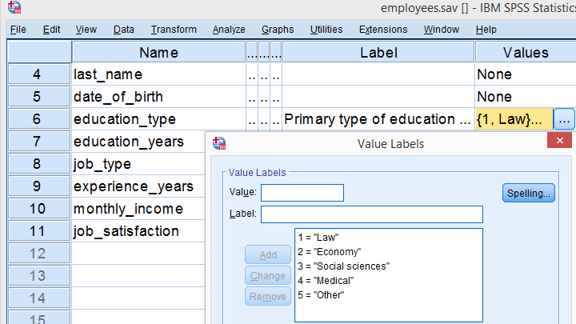
Value Label
A category that corresponds to a value and identifies exactly what the number is referring to (i.e., 0 = ‘Never’).

Slide 13
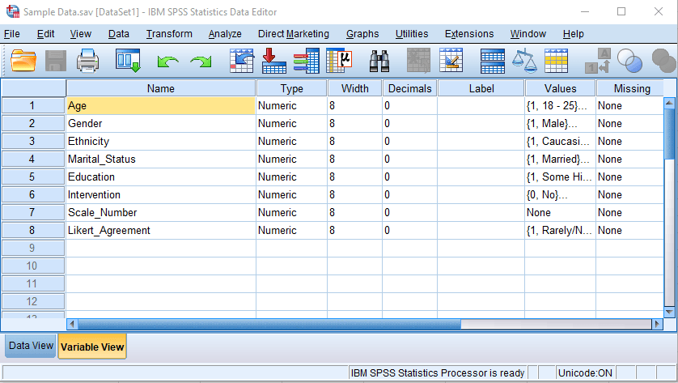
Variable
A characteristic that can change case to case.

Slide 14
Label
A description of what the variable means or measures; the description can be detailed and allows you to use spacing.

Slide 15
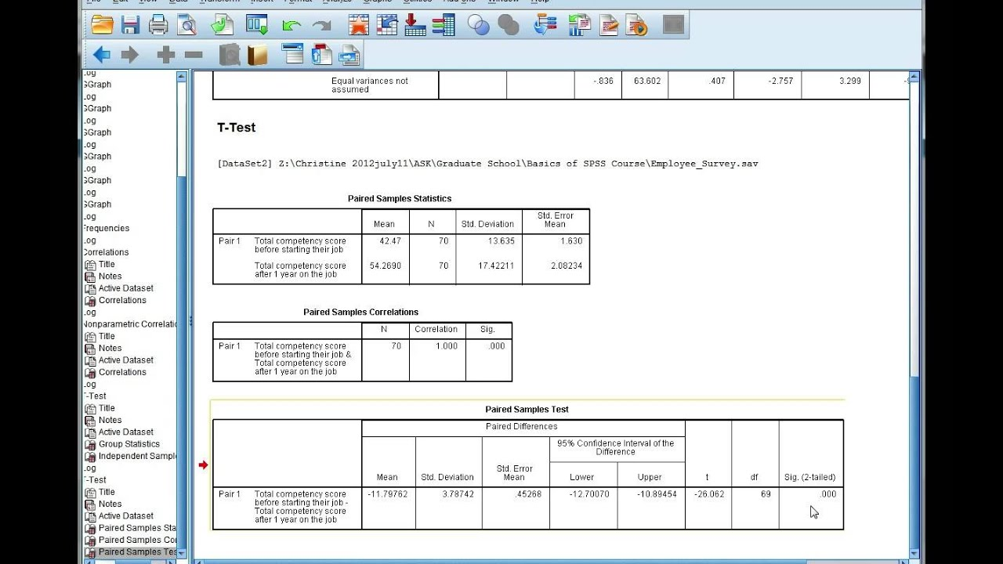
Output
A window that shows the results and summary of the programming language used to obtain those results.

Slide 16
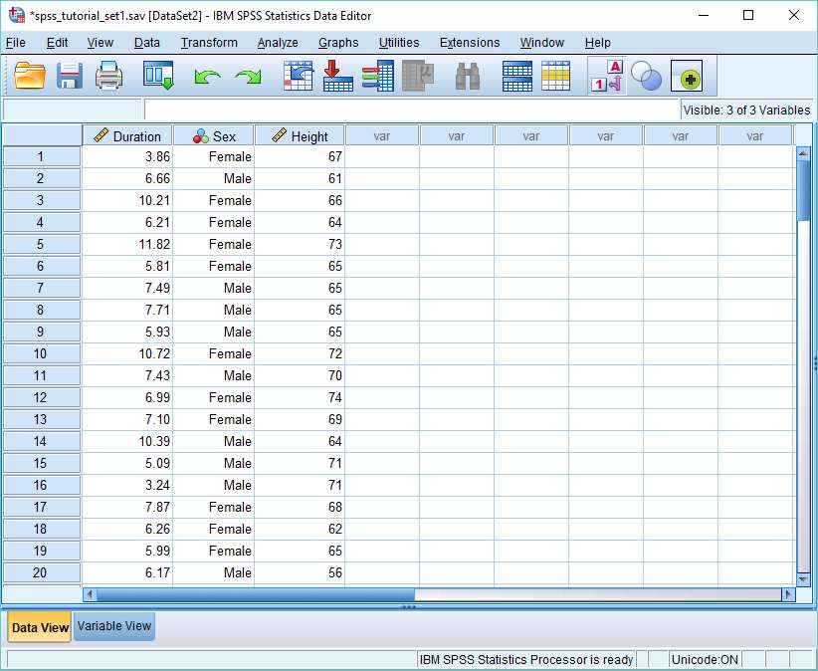
Data
Numerical or qualitative information organized and analyzed within SPSS.

Slide 17
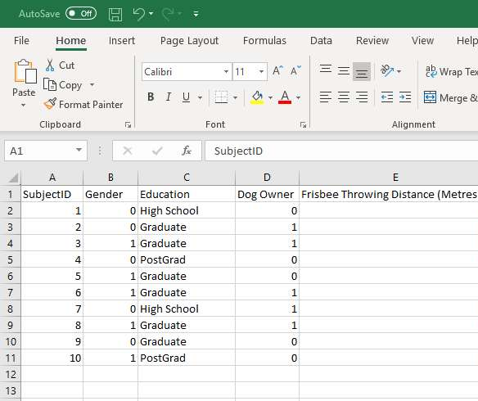
Import
Bringing data from a source outside of SPSS (i.e., Excel) into SPSS.

Slide 18
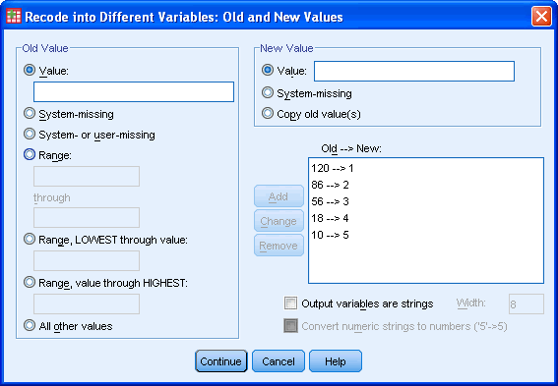
Recode
The action of systematically changing the numerical or text values of a variable (i.e., all 1s become zeroes).

Slide 19
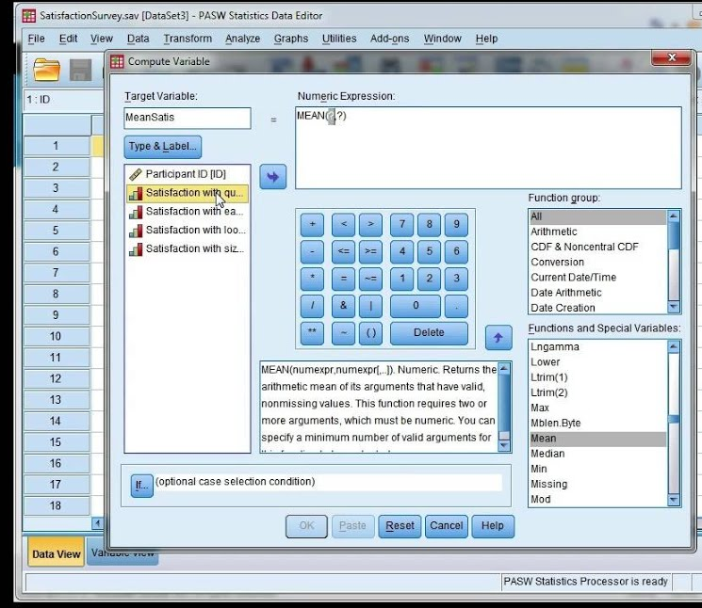
Compute
Completing calculations with your variables (i.e., adding the values of several variables to get the total score for a scale).

Slide 20
Data View
A window on SPSS that shows your raw data (i.e., the values input for each variable)

Slide 21
Variable View
A window on SPSS that shows you the list of variables that you have input into the program, along with their characteristics.

Slide 22
Data Types
Data
Nominal
Ordinal
Scale

Slide 23
Nominal Variable
Variable whose values represent categories with no intrinsic ranking (i.e., Politics).

Slide 24
Ordinal Variable
Variable whose values represent categories with some intrinsic ranking (i.e., Year of University)

Slide 25

Scale Variable
Variable whose data values indicate both the order and an equal distance between values (i.e., Income).

Slide 26
Section 2: Downloading SPSS

Slide 27
Downloading SPSS
Visit UBC’s On the Hub online store: https://ubc.onthehub.com/WebStore/Welcome.aspx
Under UBC Licensed Software, find the program IBM SPSS Statistics 27 and click OK.
1
4
2
Click Start Shopping and log in
5
Choose the platform you use on your personal computer (Windows or Mac)
3
Complete verification if necessary
6
Check out using the cart icon at the top right of the screen. The total cost should be $0.00

Slide 28
Downloading SPSS
Go to the top right of the screen. You should see a message that says “Hello ___” right beside the cart. Click there.
You will see the Download icon and an authorization code. Copy the code and press Download.
7
10
8
Select the Your Accounts/Orders option.
11
Follow the download procedure on your computer.
9
Find the relevant order (SPSS) and click View Details.
12
Enter the authorization code when you are prompted to do so.

Slide 29
Section 3: Importing & sorting data; organizing variables

Slide 30
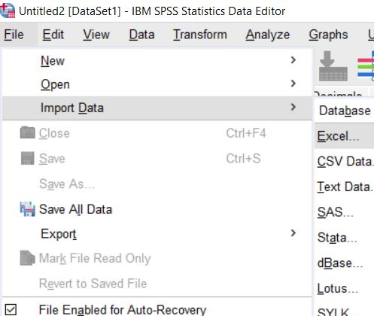
Importing Data
Open a blank SPSS file.
Click File and Import Data.
Choose your data source (Excel).

Slide 31
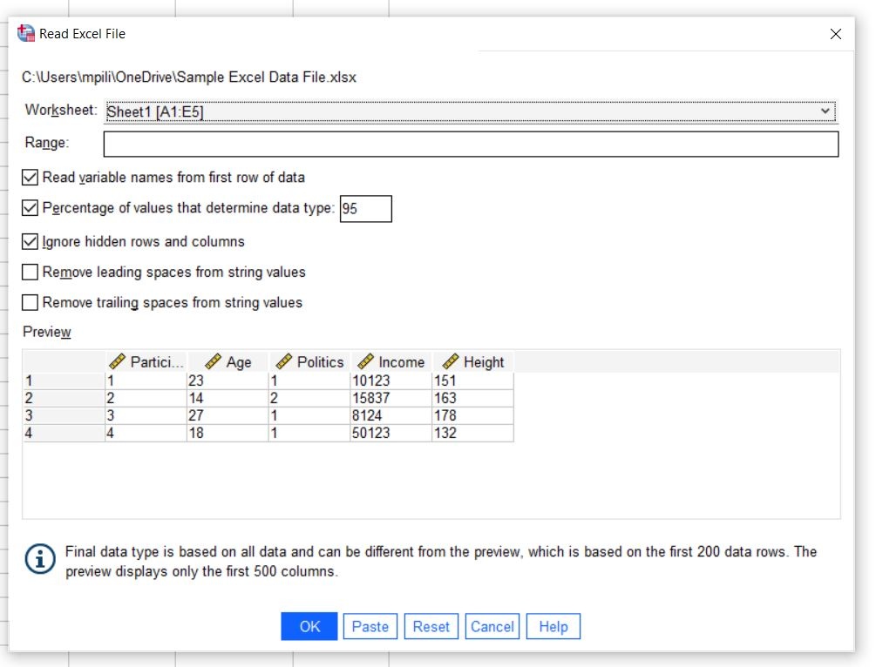
Importing Data
Find the relevant Excel file on your computer.
You will see a Read Excel File window pop up on SPSS. In this window, you will see a preview of your file.
Choose the relevant worksheet at the top of the window.

Slide 32
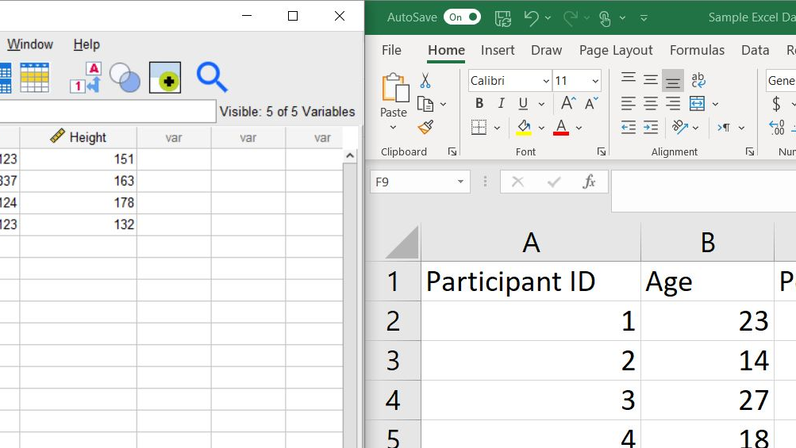
Importing Data
From the options, choose whether you want to Read variable names from the first row of data.
Press OK when you’re done.
Your file will open automatically.
Go to data view and make sure your data matches what you have on Excel.

Slide 33
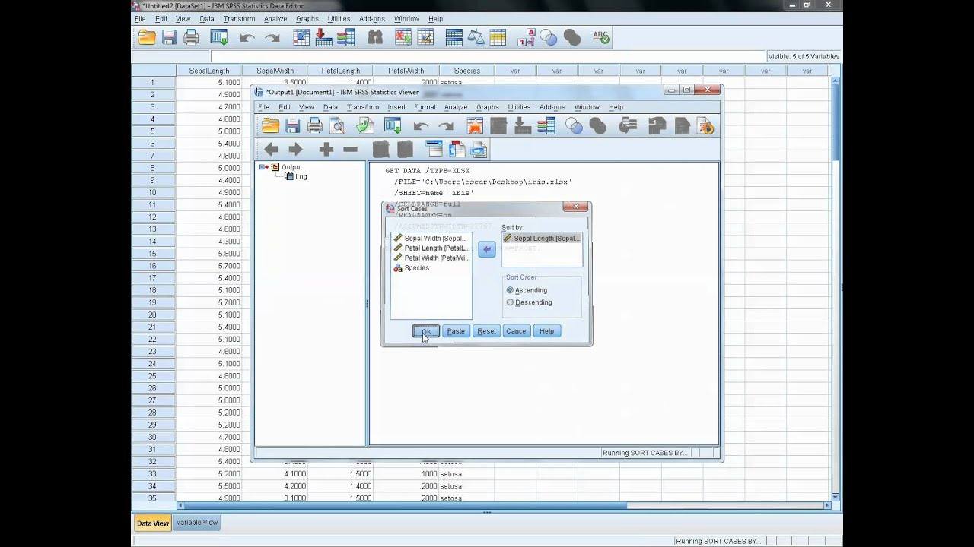
Sort Data
Go to the Data tab at the top of the page.
Click Sort Cases.
Choose the relevant variables.
Choose the sort order.
Click OK.
Notes:
Exercises:
Take the sample data file and
Sort data so that it is descending, with height as first priority and age as second

Slide 34
Variable View Options
In variable view, you can enter values for your variables.
When participants complete a survey, their responses will be coded numerically. Values allow you to assign a name for each numerical value (i.e., 1 = Law).

Slide 35
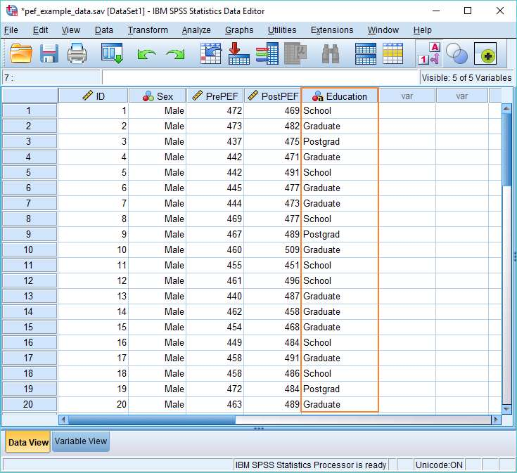
Variable View Options
If you want to see your data by the value labels instead of just in numbers, you can click on the Value Labels in data view to switch.

Slide 36
EXERCISE
Find the Language variable in your imported data file
Assign whatever value labels you want to each of the values in the Language variable

Slide 37
Section 4: Transforming Data & Using Descriptive Stats

Slide 38
Why recode a variable?
Reverse-coded questions
A scale that does not make sense to you
Uniformity of scales for data interpretation

Slide 39
Recode into Same Variables
Recode into Different Variables.
Recodes your data
Keeps the original variable and creates a new variable with new coding
Useful for beginners and easier to check for mistakes
Recodes your data
Deletes the original coding and transforms into the new code
Can be useful if you are confident in the procedure, using syntax, and trying to keep variables to a minimum

Slide 40
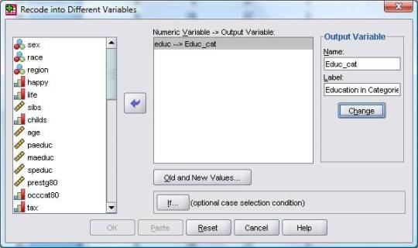
Recode into a Different Variable
1. Choose a variable from the list on the left and click the arrow to put it into the “Numeric Variable -> Output Variable” box
2. If you are recoding multiple variables (must be using the same scheme), click on the relevant variable whose name you want to change so it’s highlighted.
3. Enter the name of your new variable into the Name section of the Output Variable box (far right) and the new label in the Label section.

Slide 41
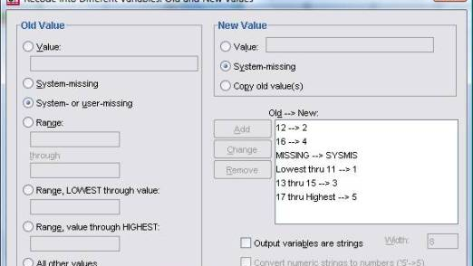
Recode into a Different Variable
4. Click on Old and New Values… (bottom)
5. In the Old Value section (left), click on the option that fits your need

Slide 42
Old Value Options
If you are just changing one particular value to another specific value.
For example
All 1s become 0s
All 1s become 2s.
If you are changing all the values within a certain range to a new specific value.
For example
All values from 1 – 3 become 1s
All values from 4 – 6 become 2s
If you are changing a missing value (either a value that is not entered or values that you have marked as missing) to a new value
For example
All System/User Missing values become 0s

Slide 43
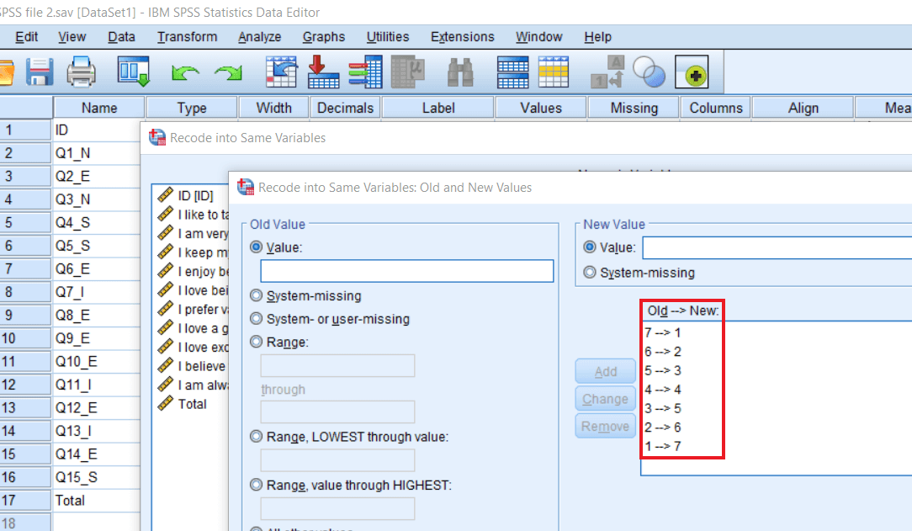
Recode into a Different Variable
7. Let’s work with just Value for now! Enter one of the original values. For example, if we are reverse coding and our current scale is 1 - 5 (Strongly Disagree to Strongly Agree), let’s start with 1.
8. Click on Value under New Value (right) and enter your new value. If we’re reverse coding, 1 will now become 5.

Slide 44
Recode into a Different Variable
9. Press ‘Add’ so the new code is entered in the Old → New box
10. Do the same for the rest of your codes. For example, 2 will now become 4, 3 will stay 3, and so on
11. Press Continue
12. Press Ok.

Slide 45
Recode into a Different Variable
CHECK YOUR WORK CAREFULLY.
Does the recoded variable look the way you want it to?
Check a random selection of participants by hand

Slide 46
EXERCISE
Take the sample data file and
Reverse code Q1_3 using recode into different variable
Recode Religion to a scheme of your choice using recode into different variable

Slide 47
Descriptive Statistics
Statistics that give you the basic characteristics of your data without running analyses or making any inferences about what the data means (i.e., no p-values)
The two main options on SPSS for descriptive statistics are
Descriptives: Characteristics of your data
Frequencies: Characteristics of your data plus frequency tables

Slide 48
QUESTION Why would printing frequency tables be useful for you in the context of your analyses?

Slide 49
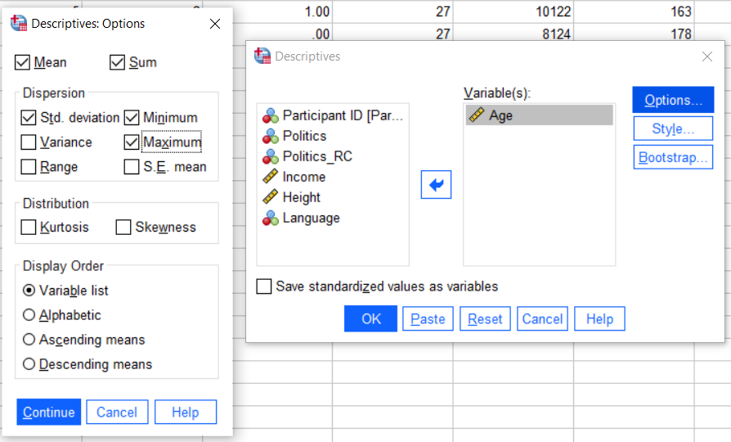
Printing Descriptives
Analyze - Descriptive Statistics - Descriptives
Select the variables you want to look at and press the arrow to put them into the Variables box
Click Options and check off the descriptive stats you want
Press Ok and an output window will pop up with your results
Notes:
Exercises:

Slide 50
EXERCISE
Take the sample data file and
Print descriptives (Mean, Median, Mode) for Income
Print descriptives (Mean and Standard deviation) for Height

Slide 51
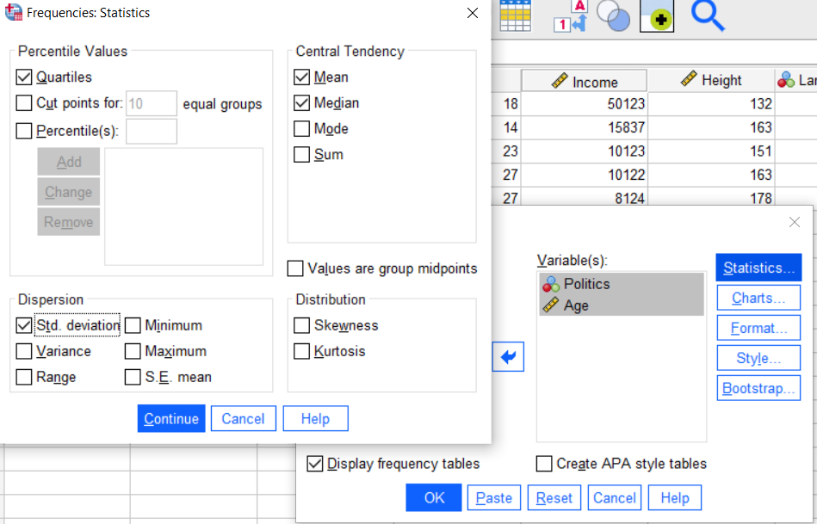
Printing Frequencies
Analyze - Descriptive Statistics - Frequencies
Select the variables you want to look at and press the arrow to put them into the Variables box
Click Statistics to select the output you want
Click Charts if you want to print a Bar Graph for each variable
Press Ok and an output window will pop up with your results
Notes:
Exercises:

Slide 52
EXERCISE
Take the sample data file and
Print frequencies (Mean, Median, Mode) for Income
Print frequencies (Mode and Frequency Table) for Language

Slide 53
Section 5: Visual Data Representation

Slide 54
Graphing Options
Legacy Dialogs
Basic charts
Limited options
Not as flexible
Chart Builder
More flexible
Building charts using individual parts
Lots more options

Slide 55
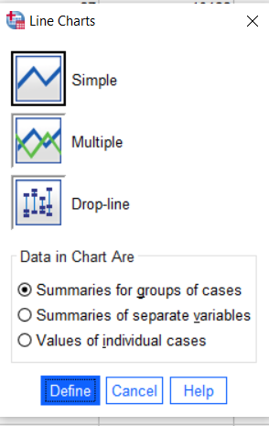
Making a Line Graph (Legacy Dialogs)
Click Graphs and then Legacy Dialogs
Select the kind of graph you are interested in building
When you do this, you will see the Line Charts dialog box
Click Simple, and then click Define. You will see the Define Simple Line dialog box.
For source, click here

Slide 56
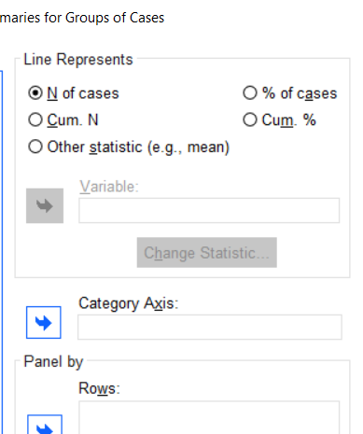
Making a Line Graph (Legacy Dialogs)
Click Politics, click to move the variable to the Category Axis: area.
Click the Other Statistic button.
Click Height, and then click to move the variable to the Variable: area.
Now is the time to enter a title or subtitle in any graph by clicking the Titles button in the Define dialog box and entering what titles, subtitles, and footnotes you want.
For source, click here

Slide 57
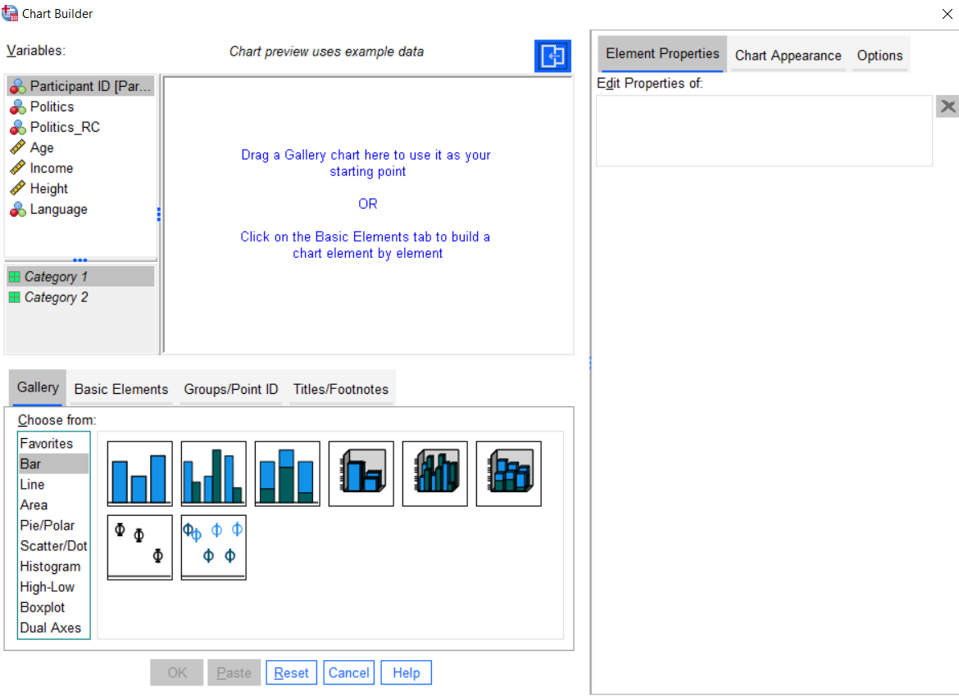
Making a Line Graph (Chart Builder)
Click on Chart Builder
Select the kind of graph you want to build (Line Graph in our example)
Drag the variable you want on the X-axis to the axis and drag the other variable to the Y-axis
Make sure that the statistic you want on the x-axis is selected under Statistic (i.e. Mean in our case, often selected automatically)
Click Ok
For source, click here
Notes:
Exercises:

Slide 58
EXERCISE
Take the sample data file and
Make a line graph for age by language using Chart Builder
Make a line graph for age by language using Legacy Dialogs

Slide 59
Section 6: Syntax & Resources

Slide 60
Syntax in SPSS

Slide 61
QUESTION Why would syntax be useful for you in the context of your analyses?

Slide 62
Why use syntax?
Syntax describes each procedure that you ran for your data
It’s a fantastic way of keeping your analyses organized.
It means that you will be able to refer back to a sheet that tells you everything you did with your data.
It also means you will be able to replicate your analyses if you have a data file with variables that had the same names.

Slide 63
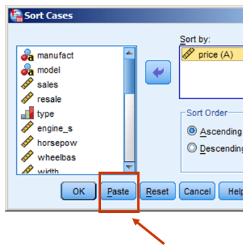
Writing Syntax
Don’t want to learn how to write syntax? No problem
Every procedure box in SPSS has a Paste button. If you press Paste, it will automatically put the syntax for that procedure into a syntax file.
Keep the syntax file open. If you want to run the procedure, you can either go back to the procedure box or highlight the syntax and press the green play button.

Slide 64
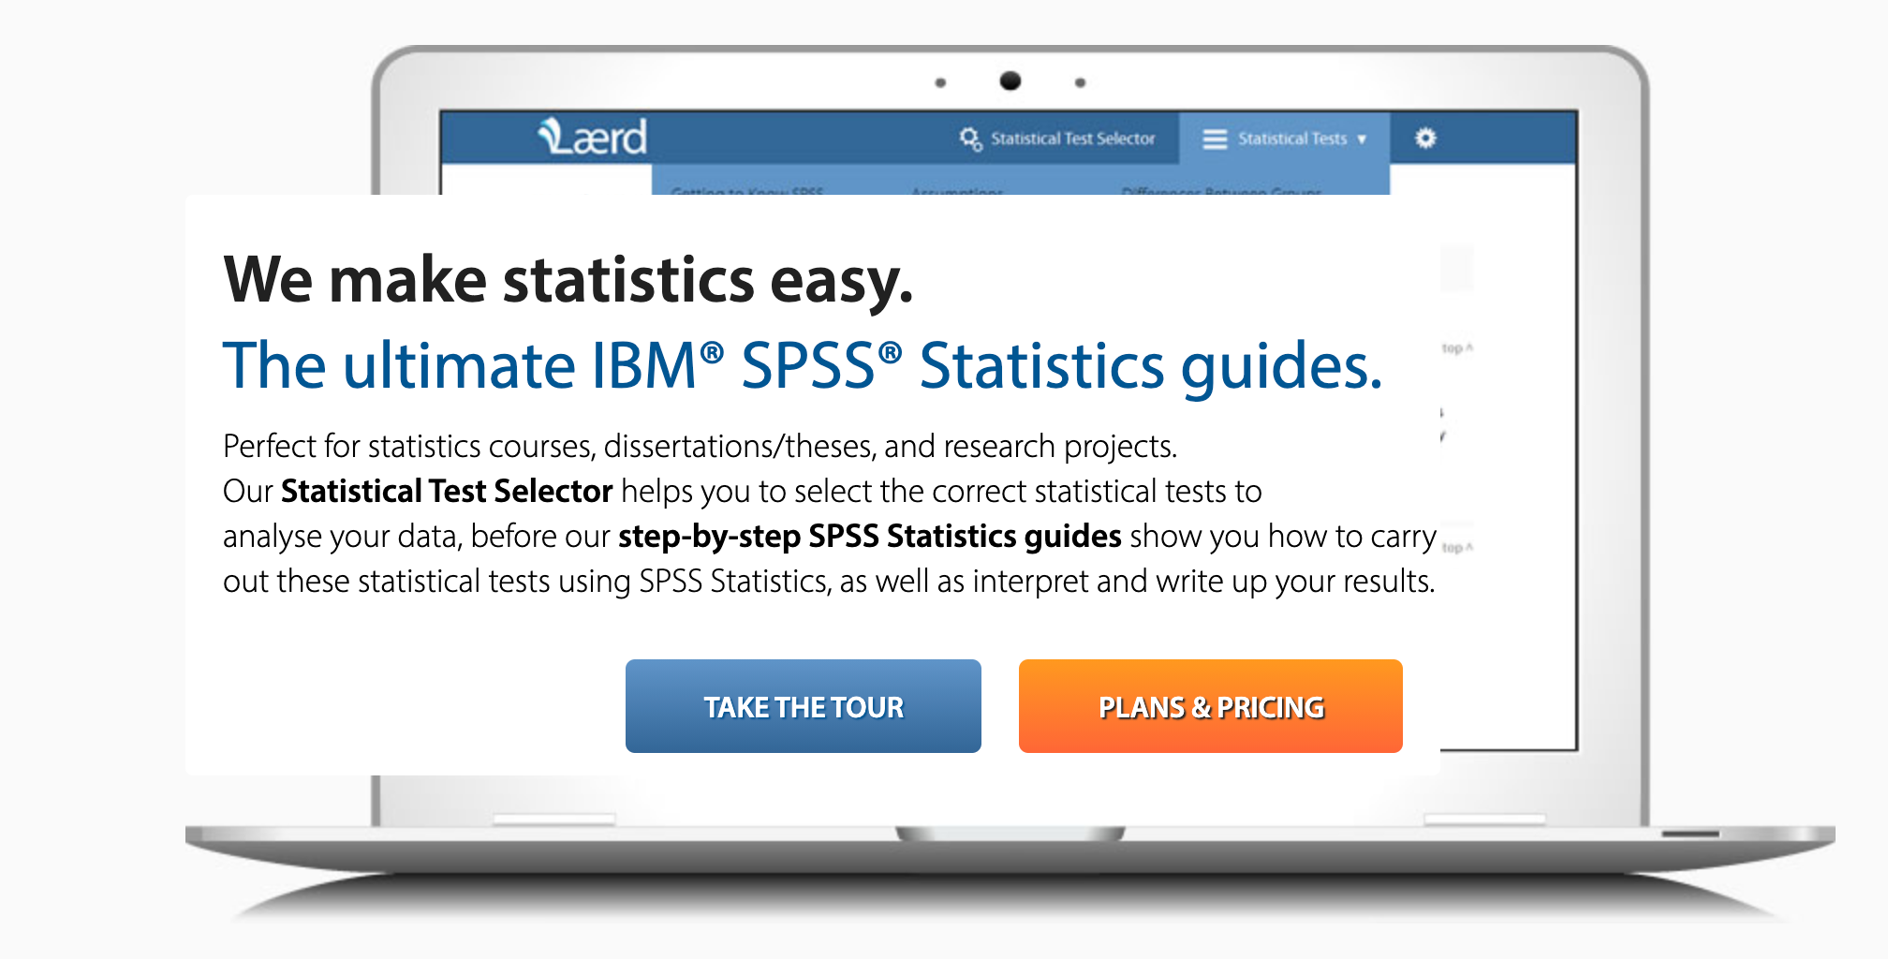
Laerd
My favourite SPSS resource
Very detailed and easy to understand
Step by step procedures
Few free resources
Reasonable pricing ($6.99/6 months)

Slide 65
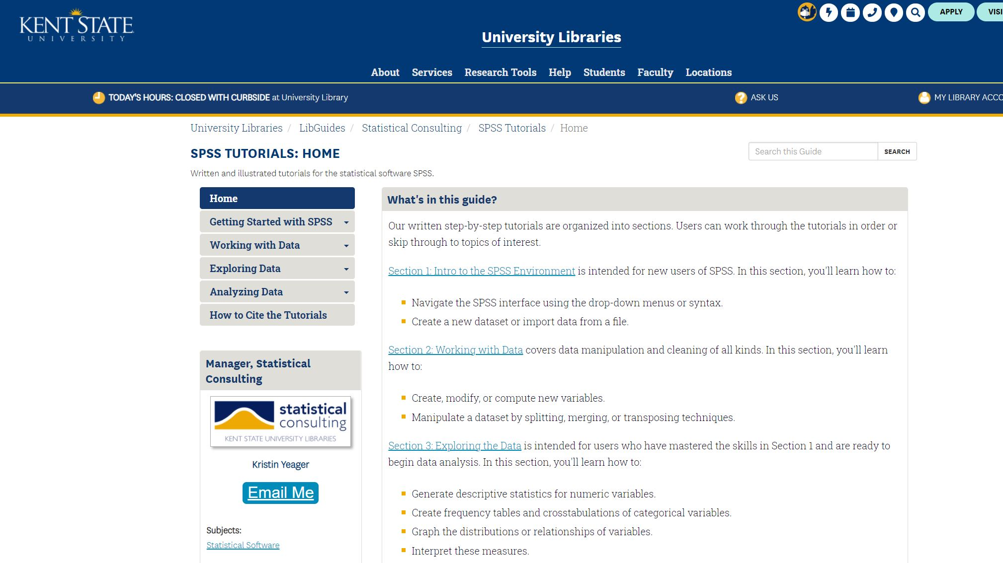
Kent State Guides
Detailed
FREE
Good for basic analyses
Unclear what version of SPSS is being used, so some instructions may be unclear, but usually only minor issue

Slide 66

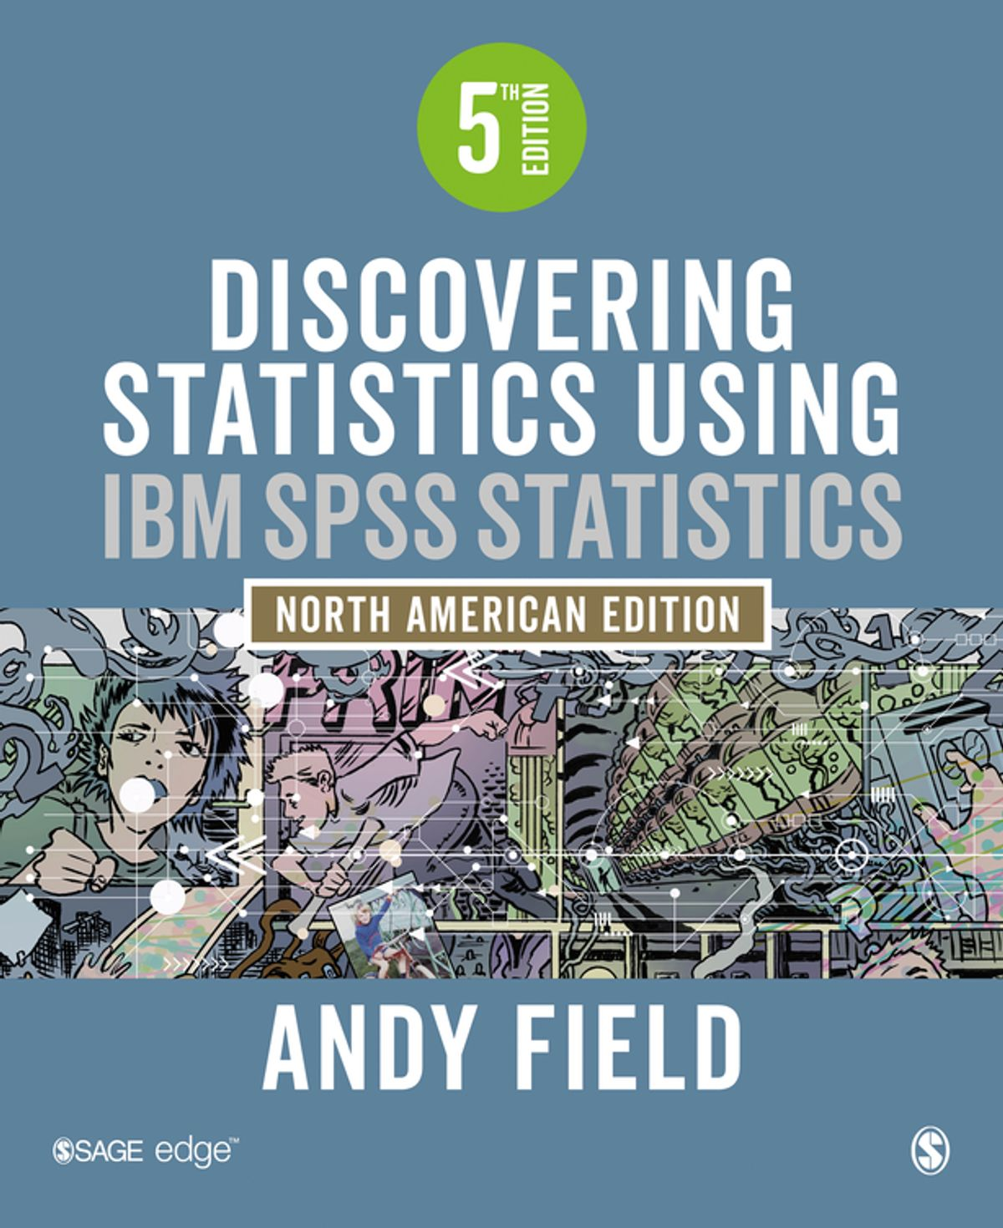
Discovering Statistics Using IBM SPSS
Easy to read and understand
Expensive ($78 for the Kindle version)
Worth it if you can afford it
First two chapters available free on author’s website

Slide 67
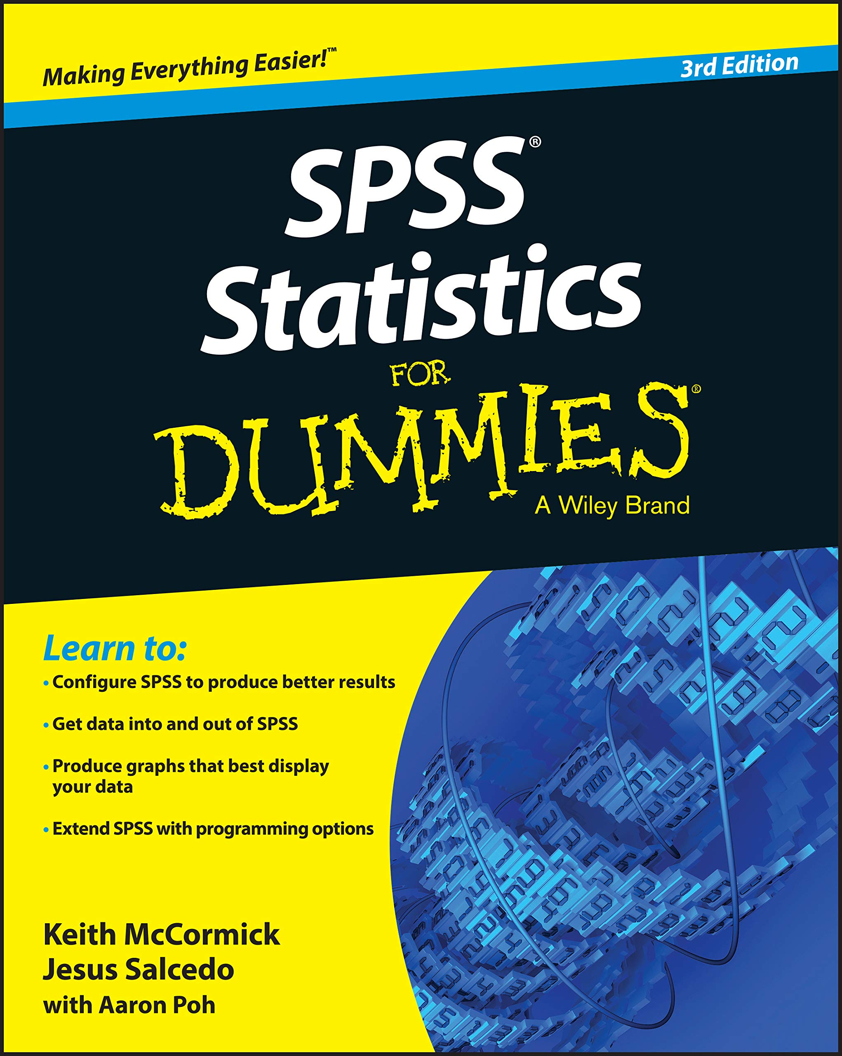
SPSS for Dummies
Ebook available at the UBC Library
Easy to navigate and straightforward
Uses older version of SPSS, so some instructions might be unclear

Slide 68

The End If you have any questions, please contact me at maya.pilin@ubc.ca

